Slide 1

A Bioinformaticians’ Guide to Python
Bioinformatics Practicum

Slide 2
HELLO, WORLD!
I am Trenton Beckendorff
I am a Second-Year CS Major, and Peer Mentor for the Big Data in Biology FRI Stream.
You can contact me at trentonbeckendorff@utexas.edu

Slide 3

Preparing for Launch
http://bit.ly/2kgkYfm

Slide 4
Installing Anaconda
1
A Python distribution for Data Science.

Slide 5


Slide 6
Running Jupyter
2
An interactive notebook for Python.

Slide 7
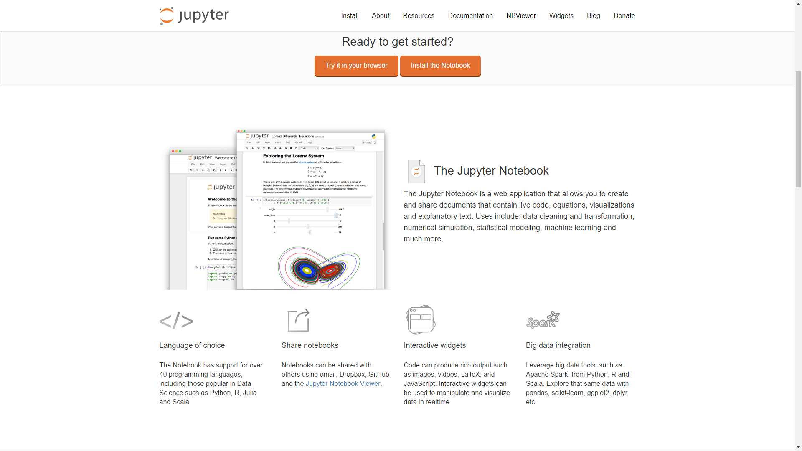

Slide 8
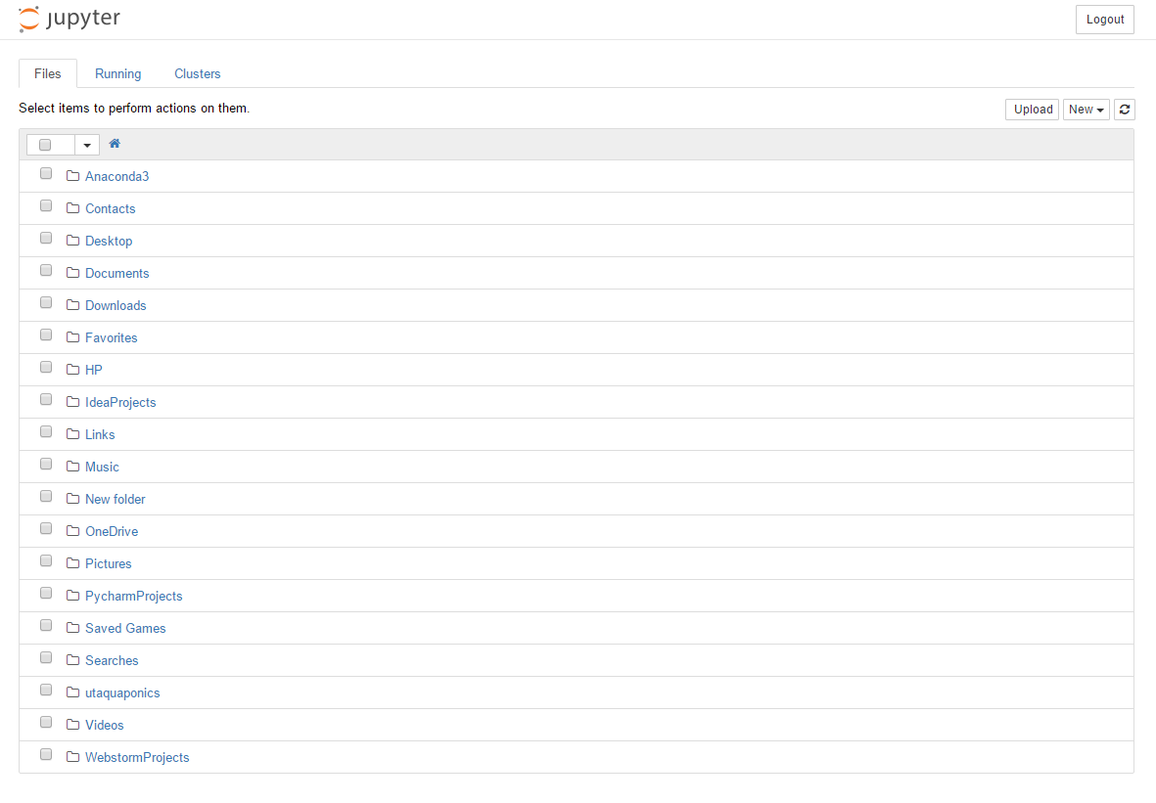
trenton@linux:~$ jupyter notebook

Slide 9
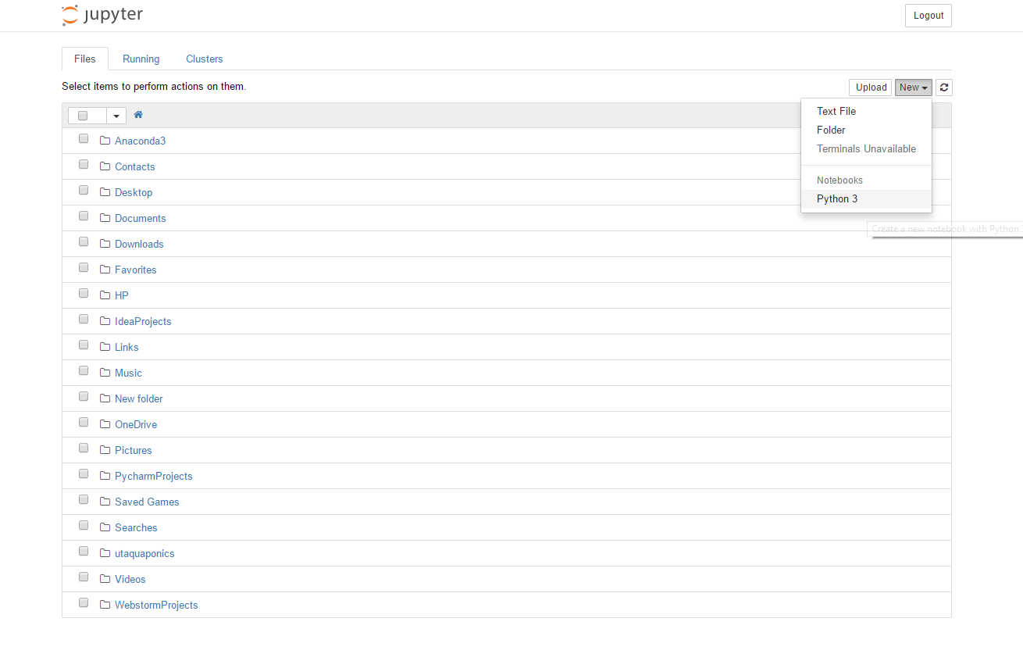
Creating a new Jupyter Notebook for Python 3.

Slide 10
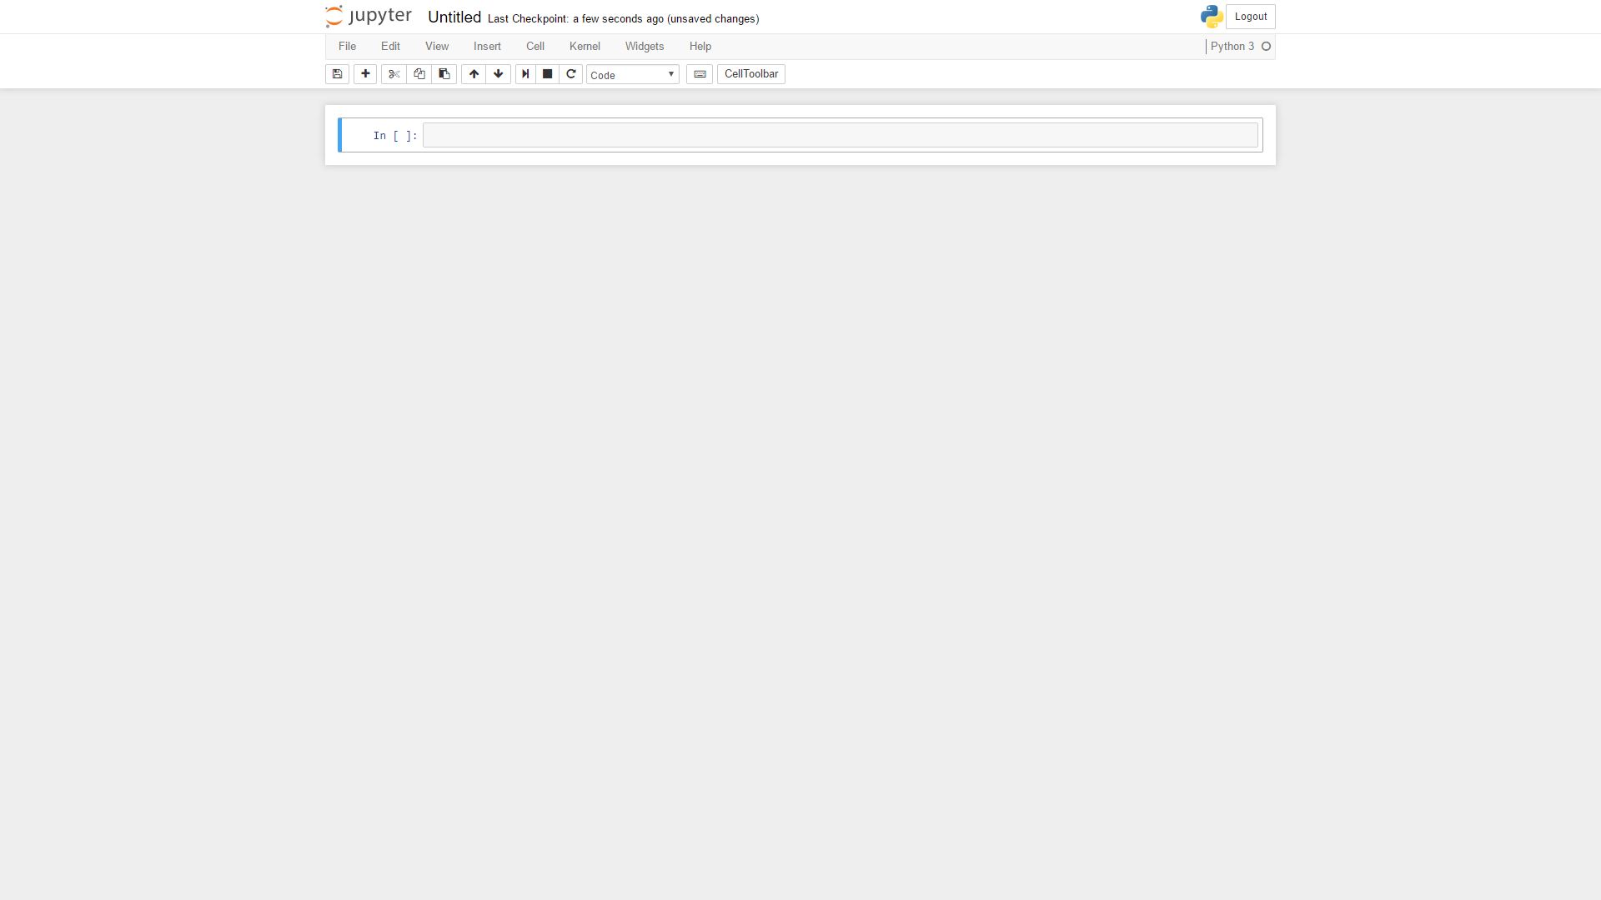

Slide 11
What is Python?
A fast, powerful, open, object-oriented, readable, all-in-one programming language.

Slide 12
Understanding the Syntax
3
Indentation, Comments, Operators, Variables, Types, Control Flow, Functions, File I/O, Imports

Slide 13
#!/usr/bin/env python def main(): print("hello, world!") if __name__ == "__main__": main()
Example 1: Hello World

Slide 14
Indentation
3.1

Slide 15
#!/usr/bin/env python def main(): print("hello")
print("hello again") if __name__ == "__main__": main()
Example 2: Indention

Slide 16
Comments
3.2

Slide 17
#!/usr/bin/env python def main: print("hello") print("hello again") # prints hello again if __name__ == "__main__": main()
Example 3: In-Line Comments

Slide 18
#!/usr/bin/env python def main: print("hello") print("hello again") ''' Run main() if executed from command line. ''' if __name__ == "__main__": main()
Example 4: Multi-Line Comments

Slide 19
Operators
3.3

Slide 20
#!/usr/bin/env python def main: print(5 + 5) # Addition print(27 / 3) # Floating-Point Division print(5 * 5) # Multiplication print(5**5) # Exponentiation print(100 // 3) # Integer Division print(5 % 4) # Remainder (modulo) print(13.5 - 14.5) # Subtraction print(True + 1) # ???? if __name__ == "__main__": main()
Example 5: Operators

Slide 21
Variables
3.4

Slide 22
#!/usr/bin/env python def main: x = 5 y = 6 z = 7 print(x - y) print(y - x) print(x + y + z) print(x == y) if __name__ == "__main__": main()
Example 6: Variables

Slide 23
Types
3.5

Slide 24
#!/usr/bin/env python def main: dna_sequence = 'ACTGACTGACTGTATATATATATATA' dna_complement = 'TGACTGACTGACATATATATATATAT' rna_sequence = 'ACUGACUGACUGUAUAUAUAUAUAUA' amino_acid = 'MetLeuSerTyrTyrGluSerIleMetLeuSerTyrTyrGluSerIle' x = 'A' x = x + 'C' print(x)
print(x[0])
print(x[1]) if __name__ == "__main__": main()
Example 7: Strings

Slide 25
#!/usr/bin/env python def main: cancer_genes = ['ABI1', 'ABL1', 'ABL2', 'ACKR3', 'ACSL3', 'ACSL6', 'AVCR1', 'AFF1'] first_gene = cancer_genes[0] print("The first gene is: " + first_gene) last_gene = cancer_genes[len(cancer_genes) - 1] print("The last gene is: " + last_gene)
cancer_genes.insert(2, 'BRCA1') print("Cancer genes: " + str(cancer_genes))
cancer_genes.append('BRCA1') print("Cancer genes: " + str(cancer_genes)) cancer_genes.remove('ABI1') print("Cancer genes: " + str(cancer_genes)) print("The number of BRCA1 genes is: " + str(cancer_genes.count('BRCA1'))) print("The index of BRCA1 is:" + str(cancer_genes.index('BRCA1'))) cancer_genes.reverse() print("Cancer genes: " + str(cancer_genes)) if __name__ == "__main__": main()
Example 8: Lists

Slide 26
#!/usr/bin/env python def main: start_codon_loc = 0 stop_codon_loc = 5 exon_loc = (start_codon_loc, stop_codon_loc + 1) print(exon_loc) print(exon_loc[0]) print(exon_loc[1]) print(exon_loc * 2) if __name__ == "__main__": main()
Example 8: Tuples

Slide 27
#!/usr/bin/env python def main: dna_to_rna = {'A':'A', 'C':'C', 'G':'G'} dna_to_rna['T'] = 'U' print(dna_to_rna['A']) print(list(dna_to_rna.keys())) print('Y' in dna_to_rna) print(list(dna_to_rna.values())) if __name__ == "__main__": main()
Example 9: Dictionaries

Slide 28
Control Flow
3.6

Slide 29
#!/usr/bin/env python def main(): if(True): print("hello")
print("hello again") else: print("goodbye") if __name__ == "__main__": main()
Example 10: If / Else

Slide 30
#!/usr/bin/env python def main: dna_sequence = 'ACTGACGTCTATATA' for base in dna_sequence: print(base) print("\n") for i in range(len(dna_sequence)): print(dna_sequence[i]) if __name__ == "__main__": main()
Example 11: For

Slide 31
#!/usr/bin/env python def main: dna_sequence = 'AAAAAACTGA' i = 0 while(dna_sequence[i] == 'A' and i < len(dna_sequence)): print(dna_sequence[i]) i = i + 1 if __name__ == "__main__": main()
Example 12: While

Slide 32
Functions
3.7

Slide 33
#!/usr/bin/env python def transcribe(dna): rna = '' for base in dna: if (base == 'T'): rna = rna + 'U' else: rna = rna + base return rna def main(): dna_sequence = 'ACTGATCAGATGCA' rna = transcribe(dna_sequence) print(rna) if __name__ == "__main__": main()
Example 13: Functions

Slide 34
File I/O
3.8

Slide 35
#!/usr/bin/env python def transcribe(dna): rna = '' for base in dna: if (base == 'T'): rna = rna + 'U' else: rna = rna + base return rna def main(): f = open('dna_sample.txt', 'r') # Read the dna sample file. dna_sample = f.read() print(dna_sample) print("\n") rna_sample = transcribe(dna_sample) print(rna_sample) w = open('rna_sample.txt', 'w') w.write(rna_sample) if __name__ == '__main__': main()
Example 14: File I/O

Slide 36
Simple, yet Powerful

Slide 37
Next Time: Applying Python to Bioinformatics
4

Slide 38
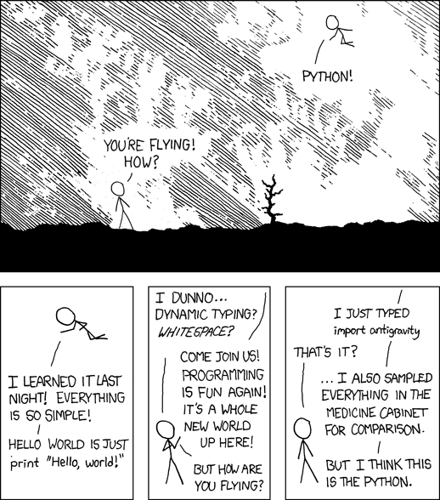

Slide 39
THANKS!
Any questions?
You can find me at
trentonbeckendorff@utexas.edu

Slide 40
Citations
Startup icon made by Maxim Basinski from www.flaticon.com
Presentation slide template by SlidesCarnival
Python comic by XKCD

Slide 41
Indentation:
use 4 spaces per indentation level
‘hanging indentations’ should be distinguishable
Tabs or Spaces?
spaces > tabs
Python 3: no mixing of tabs and spaces
Line Length:
maximum of 79 characters
limit docstrings / comments to 72 characters
Blank Lines:
use in functions (sparingly) to separate logical sections
2 blank lines b/t functions
Source File Encoding:
UTF-8
Imports:
use separate line for each import
always at the top of the file
standard library imports
third party imports
local imports
Quotes:
double or single
Whitespace:
avoid extraneous whitespace
always surround operators
Comments:
should be complete sentences
should be updated when modifying code
inline comments: use sparingly
PEP8 Style Guide: Key Concepts

